Slide 1


Introduction
COMPSCI 453 Computer Networks
Professor Jim Kurose
College of Information and Computer Sciences
University of Massachusetts
Overview. What is the Internet? What is a protocol?
Network edge
Network core: packet/circuit switching, internet structure
Performance: loss, delay, throughput
Protocol layers, service models
Security
History
Class textbook:
Computer Networking: A Top-Down Approach (8th ed.)
J.F. Kurose, K.W. Ross
Pearson, 2020
http://gaia.cs.umass.edu/kurose_ross

Slide 2
















The network core
mesh of interconnected routers
packet-switching: hosts break application-layer messages into packets
network forwards packets from one router to the next, across links on path from source to destination
mobile network
national or global ISP
local or regional ISP
home network
content
provider
network
datacenter
network
enterprise
network

Slide 3
Two key network-core functions
routing algorithm
Routing:
global action: determine source-destination paths taken by packets
routing algorithms
routing algorithm
Forwarding:
aka “switching”
local action: move arriving packets from router’s input link to appropriate router output link
local forwarding table
local forwarding table
header value
output link
0100
0101
0111
1001
3
2
2
1
1
3
2
0111
destination address in arriving
packet’s header

Slide 4
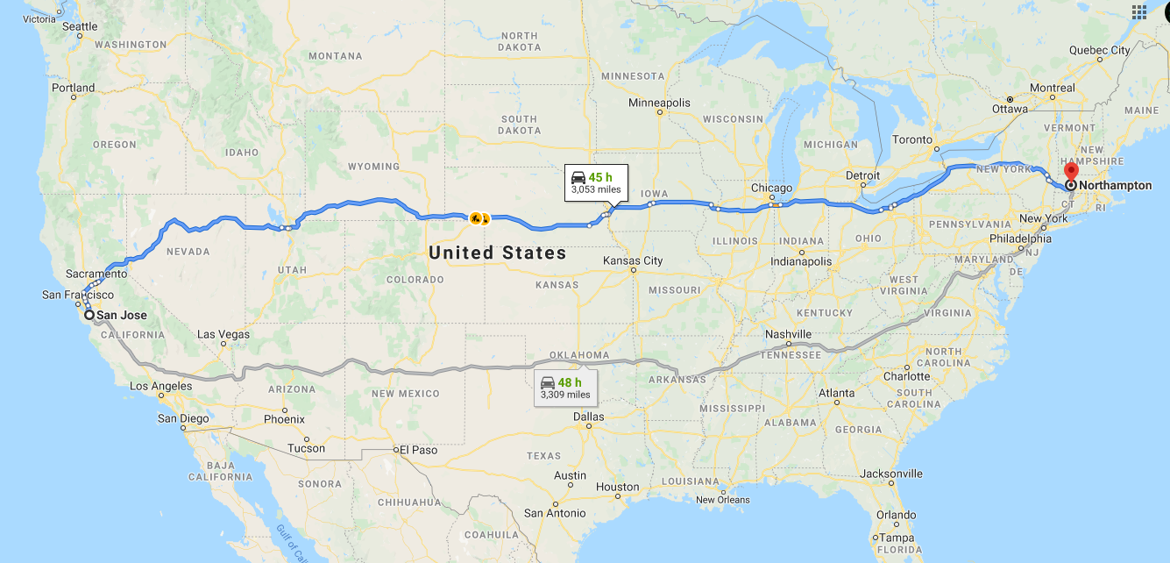
routing

Slide 5
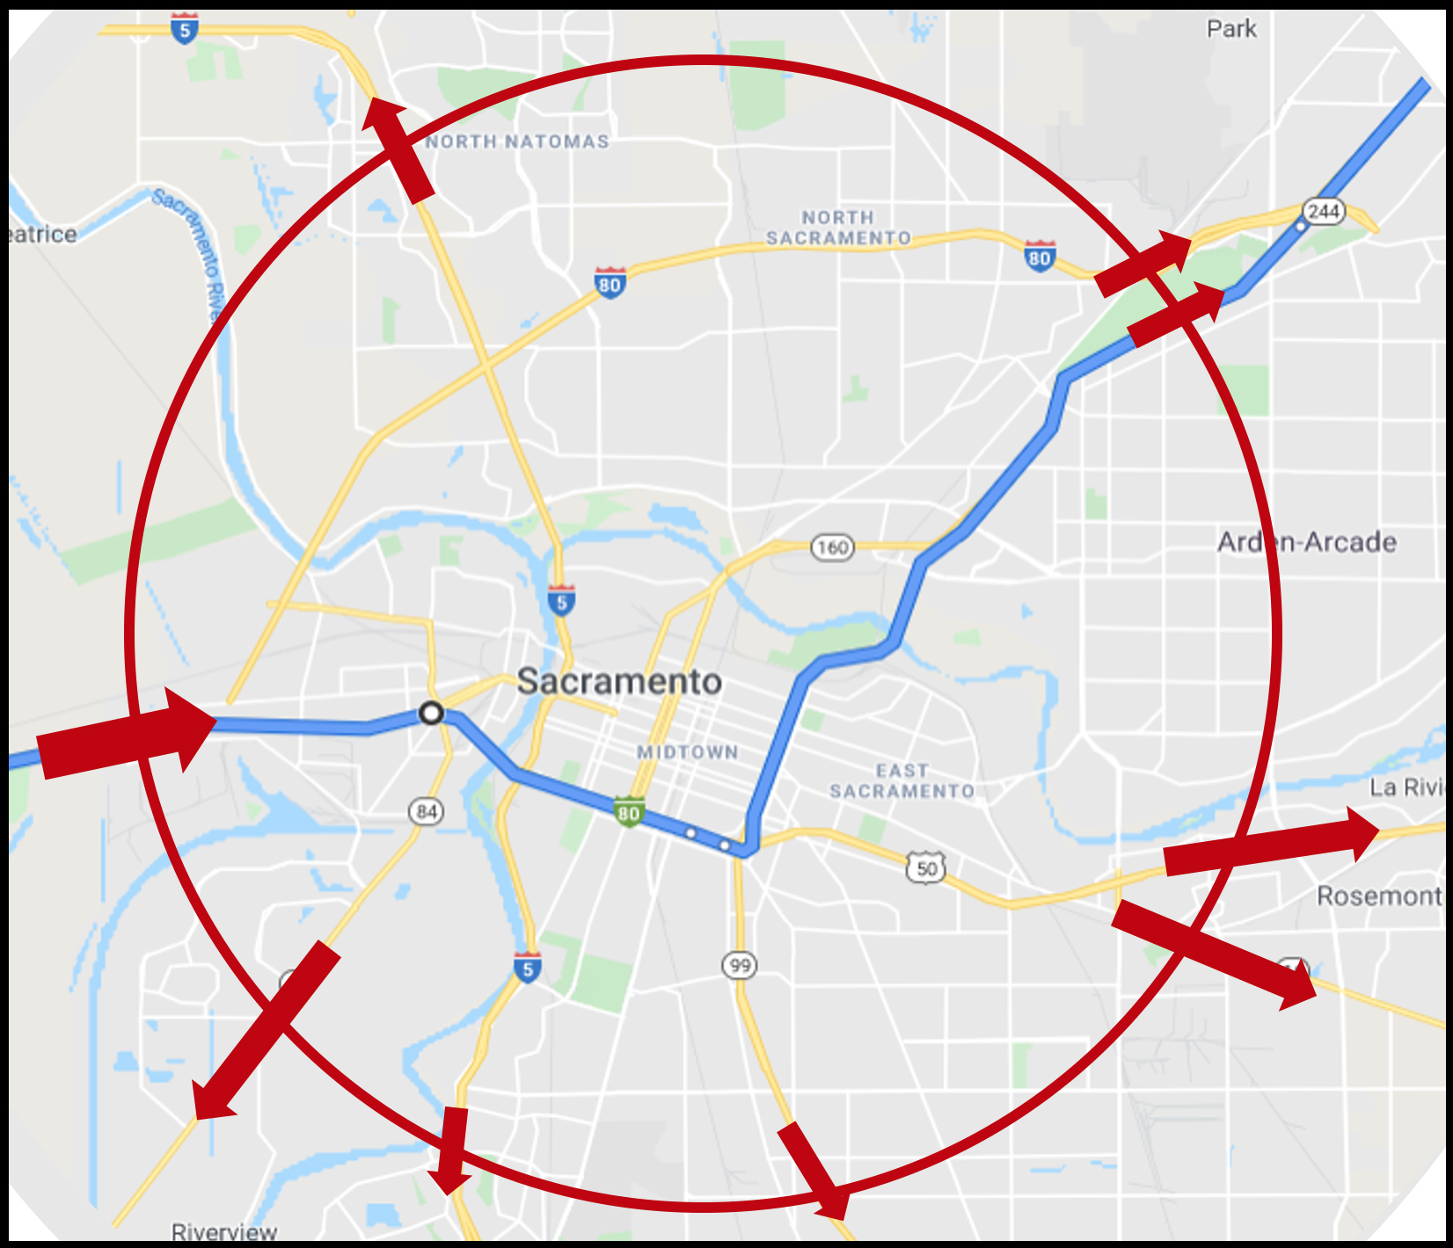
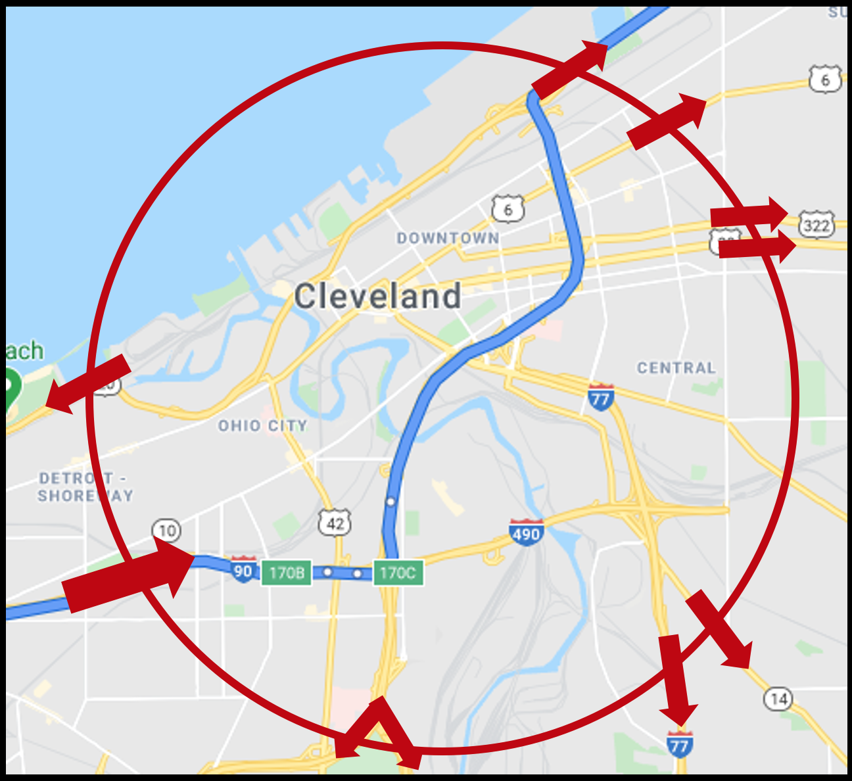
forwarding
forwarding

Slide 6




Packet-switching: store-and-forward
L bits
per packet
source
3
2
1
destination
R bps
R bps
packet transmission delay: takes L/R seconds to transmit (push out) L-bit packet into link at R bps
store and forward: entire packet must arrive at router before it can be transmitted on next link
One-hop numerical example:
L = 10 Kbits
R = 100 Mbps
one-hop transmission delay = 0.1 msec

Slide 7
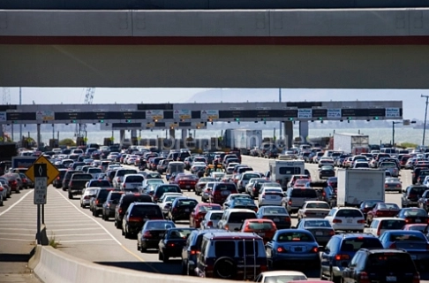

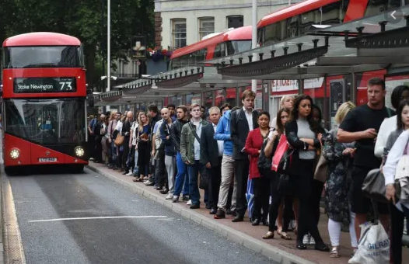
Packet-switching: queueing
R = 100 Mb/s
C
A
R = 1.5 Mb/s
D
B
E
queue of packets
waiting for transmission over output link
Queueing occurs when work arrives faster than it can be serviced:

Slide 8
Packet-switching: queueing
R = 100 Mb/s
C
A
R = 1.5 Mb/s
D
B
E
queue of packets
waiting for transmission over output link
Packet queuing and loss: if arrival rate (in bps) to link exceeds transmission rate (bps) of link for some period of time:
packets will queue, waiting to be transmitted on output link
packets can be dropped (lost) if memory (buffer) in router fills up

Slide 9
Alternative to packet switching: circuit switching
end-end resources allocated to, reserved for “call” between source and destination
in diagram, each link has four circuits.
call gets 2nd circuit in top link and 1st circuit in right link.
dedicated resources: no sharing
circuit-like (guaranteed) performance
circuit segment idle if not used by call (no sharing)
commonly used in traditional telephone networks
* Check out the online interactive exercises for more examples: http://gaia.cs.umass.edu/kurose_ross/interactive

Slide 10
Circuit switching: FDM and TDM
Frequency Division Multiplexing (FDM)
optical, electromagnetic frequencies divided into (narrow) frequency bands
4 users
frequency
each call allocated its own band, can transmit at max rate of that narrow band
time
Time Division Multiplexing (TDM)
time divided into slots
frequency
each call allocated periodic slot(s), can transmit at maximum rate of (wider) frequency band (only) during its time slot(s)
time

Slide 11
Packet switching versus circuit switching
example:
1 Gb/s link
each user:
100 Mb/s when “active”
active 10% of time
…..
N
users
1 Gbps link
Q: how many users can use this network under circuit-switching and packet switching?
circuit-switching: 10 users
packet switching: with 35 users, probability > 10 active at same time is less than .0004 *
Q: how did we get value 0.0004?
A: HW problem (for those with course in probability only)
* Check out the online interactive exercises for more examples: http://gaia.cs.umass.edu/kurose_ross/interactive

Slide 12
Packet switching versus circuit switching
Is packet switching a “slam dunk winner”?
great for “bursty” data – sometimes has data to send, but at other times not
resource sharing
simpler, no call setup
excessive congestion possible: packet delay and loss due to buffer overflow
protocols needed for reliable data transfer, congestion control
Q: How to provide circuit-like behavior with packet-switching?
“It’s complicated.” We’ll study various techniques that try to make packet switching as “circuit-like” as possible.
Q: human analogies of reserved resources (circuit switching) versus on-demand allocation (packet switching)?

Slide 13
Internet structure: a “network of networks”
hosts connect to Internet via access Internet Service Providers (ISPs)
access ISPs in turn must be interconnected
so that any two hosts (anywhere!) can send packets to each other
resulting network of networks is very complex
evolution driven by economics, national policies
mobile network
national or global ISP
local or regional ISP
home network
content
provider
network
datacenter
network
enterprise
network
Let’s take a stepwise approach to describe current Internet structure

Slide 14
Internet structure: a “network of networks”
Question: given millions of access ISPs, how to connect them together?
…
…
access
net
access
net
access
net
access
net
access
net
access
net
access
net
…
…
access
net
access
net
access
net
access
net
access
net
access
net
…
access
net
access
net
…
access
net

Slide 15
Internet structure: a “network of networks”
Question: given millions of access ISPs, how to connect them together?
…
…
access
net
access
net
access
net
access
net
access
net
…
…
access
net
access
net
connecting each access ISP to each other directly doesn’t scale: O(N²) connections.
…
…
…
access
net
access
net
…
access
net
access
net
access
net
…
access
net
…
access
net
access
net
…
access
net

Slide 16
Internet structure: a “network of networks”
Option: connect each access ISP to one global transit ISP?
Customer and provider ISPs have economic agreement.
…
…
access
net
access
net
access
net
access
net
access
net
access
net
access
net
…
…
global ISP
access
net
access
net
access
net
access
net
access
net
access
net
…
access
net
access
net
…
access
net

Slide 17
Internet structure: a “network of networks”
But if one global ISP is viable business, there will be competitors ….
…
…
access
net
access
net
access
net
access
net
access
net
access
net
ISP A
access
net
…
…
access
net
ISP B
access
net
ISP C
access
net
access
net
access
net
access
net
…
access
net
access
net
…
access
net

Slide 18
Internet structure: a “network of networks”
But if one global ISP is viable business, there will be competitors …. who will want to be connected
Internet exchange point
…
…
access
net
access
net
access
net
access
net
access
net
IXP
access
net
access
net
ISP A
…
…
access
net
IXP
ISP B
access
net
ISP C
access
net
access
net
peering link
access
net
access
net
…
access
net
access
net
…
access
net

Slide 19
Internet structure: a “network of networks”
… and regional networks may arise to connect access nets to ISPs
…
…
access
net
access
net
access
net
access
net
access
net
IXP
access
net
access
net
ISP A
…
…
access
net
IXP
ISP B
access
net
ISP C
access
net
access
net
access
net
regional ISP
access
net
…
access
net
access
net
…
access
net

Slide 20
Internet structure: a “network of networks”
… and content provider networks (e.g., Google, Microsoft, Akamai) may run their own network, to bring services, content close to end users
…
…
access
net
access
net
access
net
access
net
access
net
IXP
access
net
access
net
ISP A
…
…
Content provider network
access
net
IXP
ISP B
access
net
ISP C
access
net
access
net
access
net
regional ISP
access
net
…
access
net
access
net
…
access
net

Slide 21
Internet structure: a “network of networks”
Tier 1 ISP
Tier 1 ISP
Google
IXP
IXP
IXP
Regional ISP
Regional ISP
access
ISP
access
ISP
access
ISP
access
ISP
access
ISP
access
ISP
access
ISP
access
ISP
At “center”: small # of well-connected large networks
“tier-1” commercial ISPs (e.g., Level 3, Sprint, AT&T, NTT), national & international coverage
content provider networks (e.g., Google, Facebook): private network that connects its data centers to Internet, often bypassing tier-1, regional ISPs

Slide 22
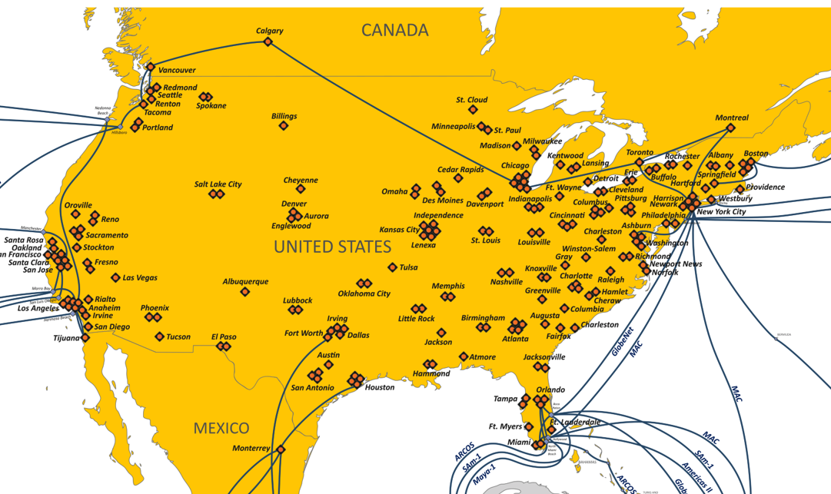
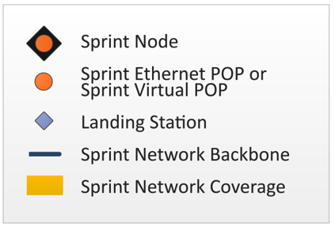
Tier-1 ISP Network map: Sprint (2019)
POP: point-of-presence
to/from other Sprint PoPS
links to peering networks
…
…
…
…
…
links to/from Sprint customer networks

Slide 23

Introduction
COMPSCI 453 Computer Networks
Professor Jim Kurose
College of Information and Computer Sciences
University of Massachusetts
Overview. What is the Internet? What is a protocol?
Network edge
Network core: packet/circuit switching, internet structure
Performance: loss, delay, throughput
Protocol layers, service models
Security
History
Class textbook:
Computer Networking: A Top-Down Approach (8th ed.)
J.F. Kurose, K.W. Ross
Pearson, 2020
http://gaia.cs.umass.edu/kurose_ross
Video: 2020, J.F. Kurose, All Rights Reserved
Powerpoint: 1996-2020, J.F. Kurose, K.W. Ross, All Rights Reserved

